Slide 1

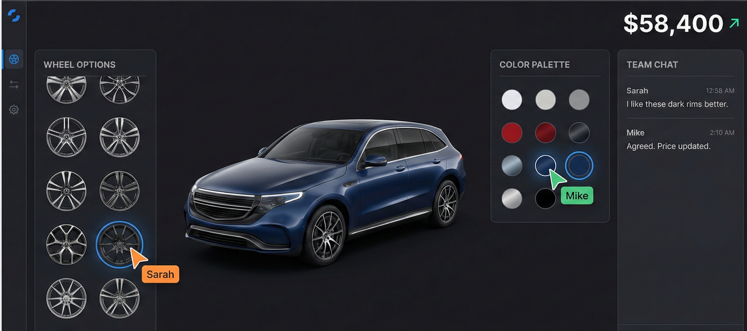
Collaborative Car Configuration Platform
AI-powered, real-time car customization and multi-user collaboration.
Problems
Car buying is a multi-person decision, but current configurators are built for only one user at a time.
Fragmented communication — buyers discuss options on WhatsApp/phone while configuring separately, leading to confusion and repeated work.
Many buyers aren’t sure which parts or features are right for them, so they end up confused. A helpful recommendation system is needed.

Slide 2
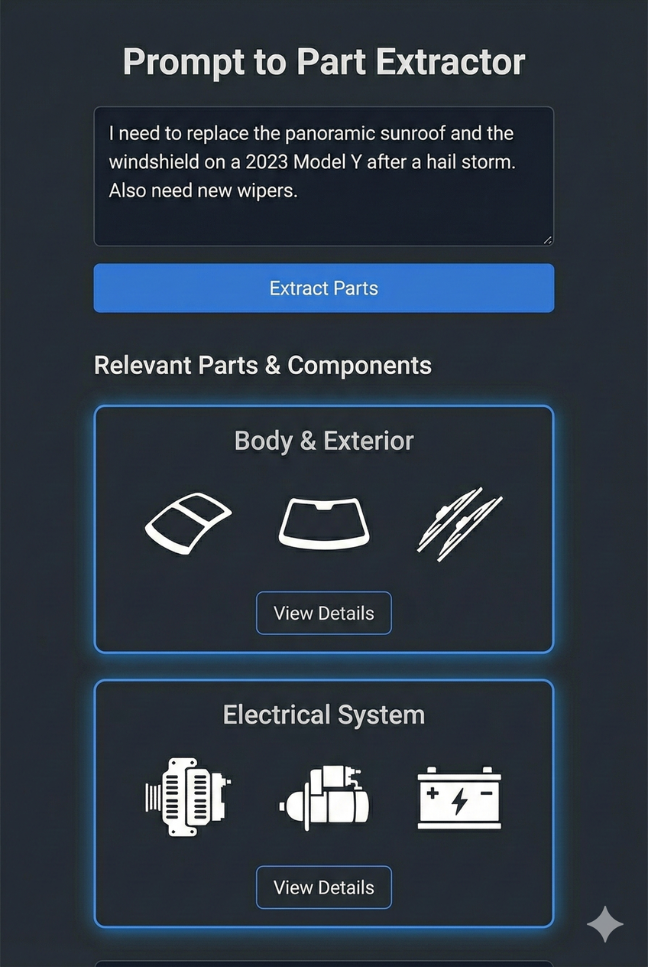
What Are We Building
A real-time multi-user web platform where users collaborate to configure a car, see pricing instantly, ask questions, and get AI assistance.
Key Features
1.)Live Preview with Multi-Cursor: Everyone can make changes together and see each other's cursor in real time. As we pick parts, the price updates instantly, and we can switch payment methods on the spot.
2.)Prompt- based Requirement: Text Input → AI suggests features/part.

Slide 3
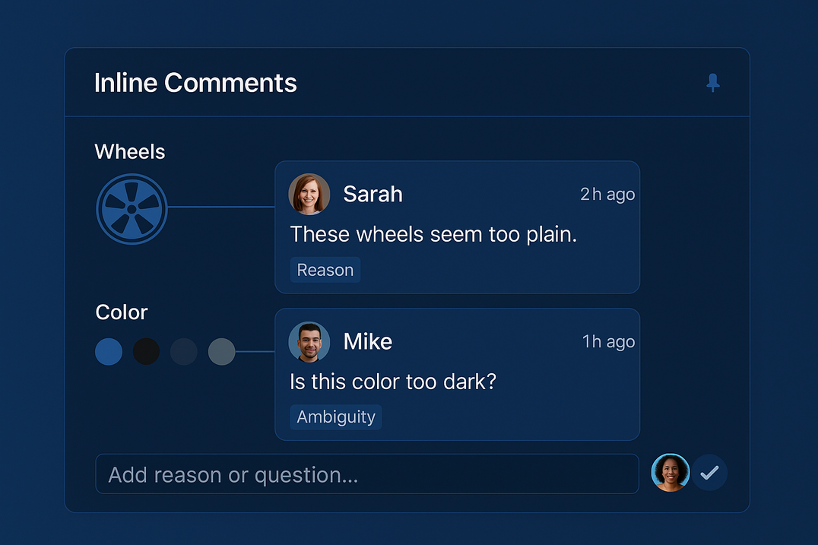
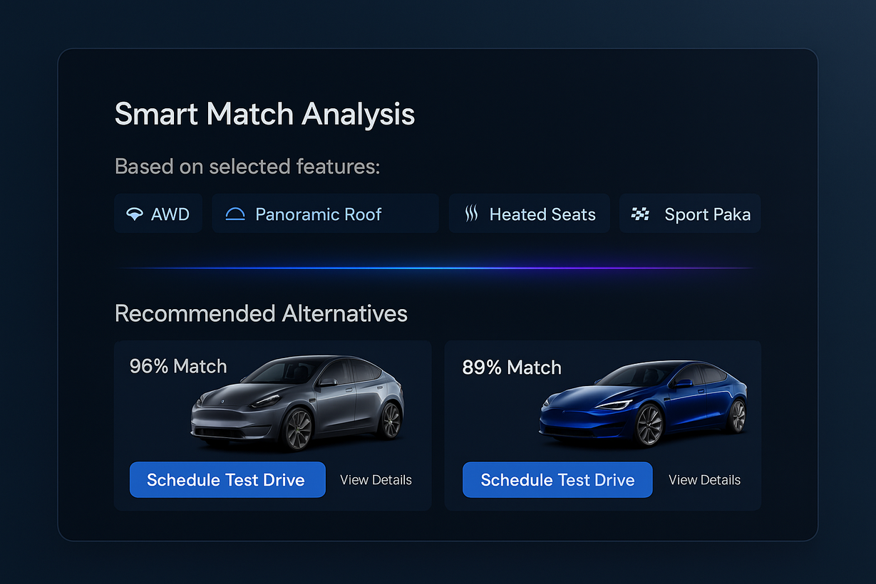
What Are We Building
3.)Inline Chats: Clients can write small notes or reasons beside any feature, or mark areas where they are confused, so all decisions stay clear.
4.)Smart Match Analysis: Checks the current configuration of the car and suggest the car which have similar configuration helping clients to have a rough estimate about what final car would look like in real life and do some test drive

Slide 4
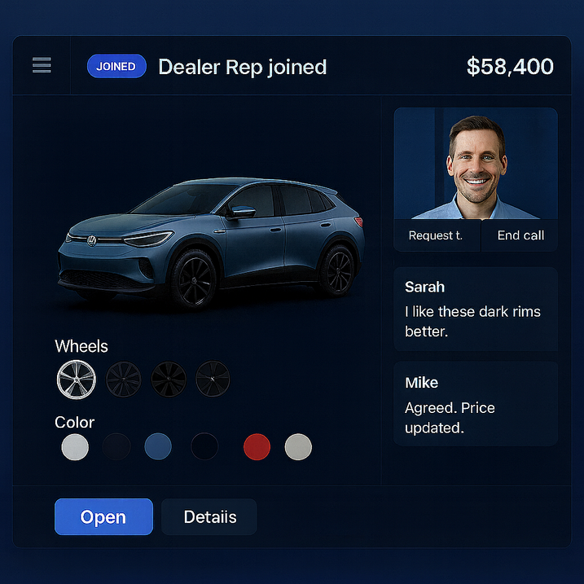
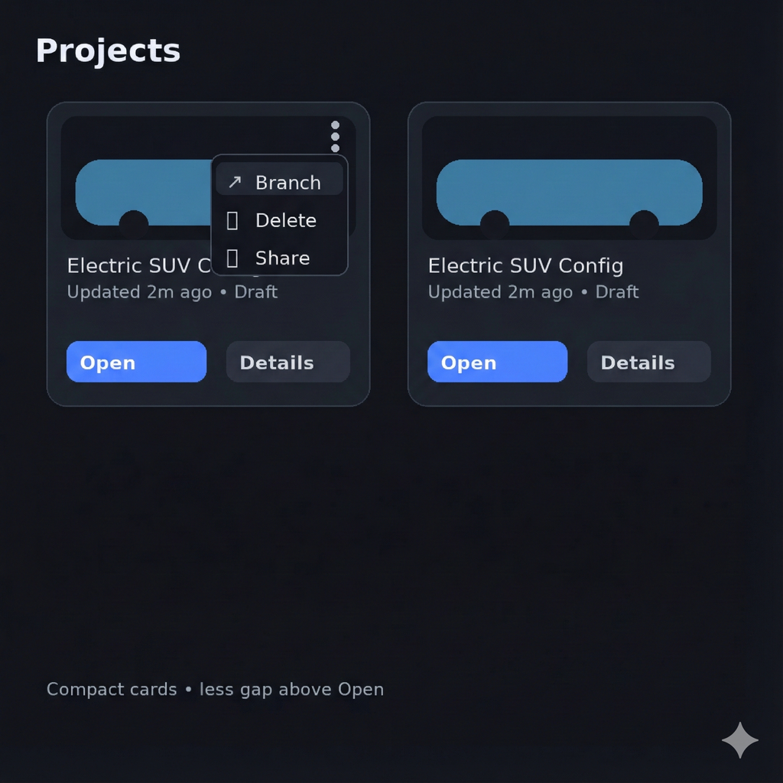
What Are We Building
5.) Expert Call Support: Clients can call an expert directly if they’re unsure about how a part works or need quick clarification.
6.) Project-Based Car Builds: Clients can save their builds as projects, share them for collaboration, and even create branches if they want to try different versions and compare the final results.

Slide 5
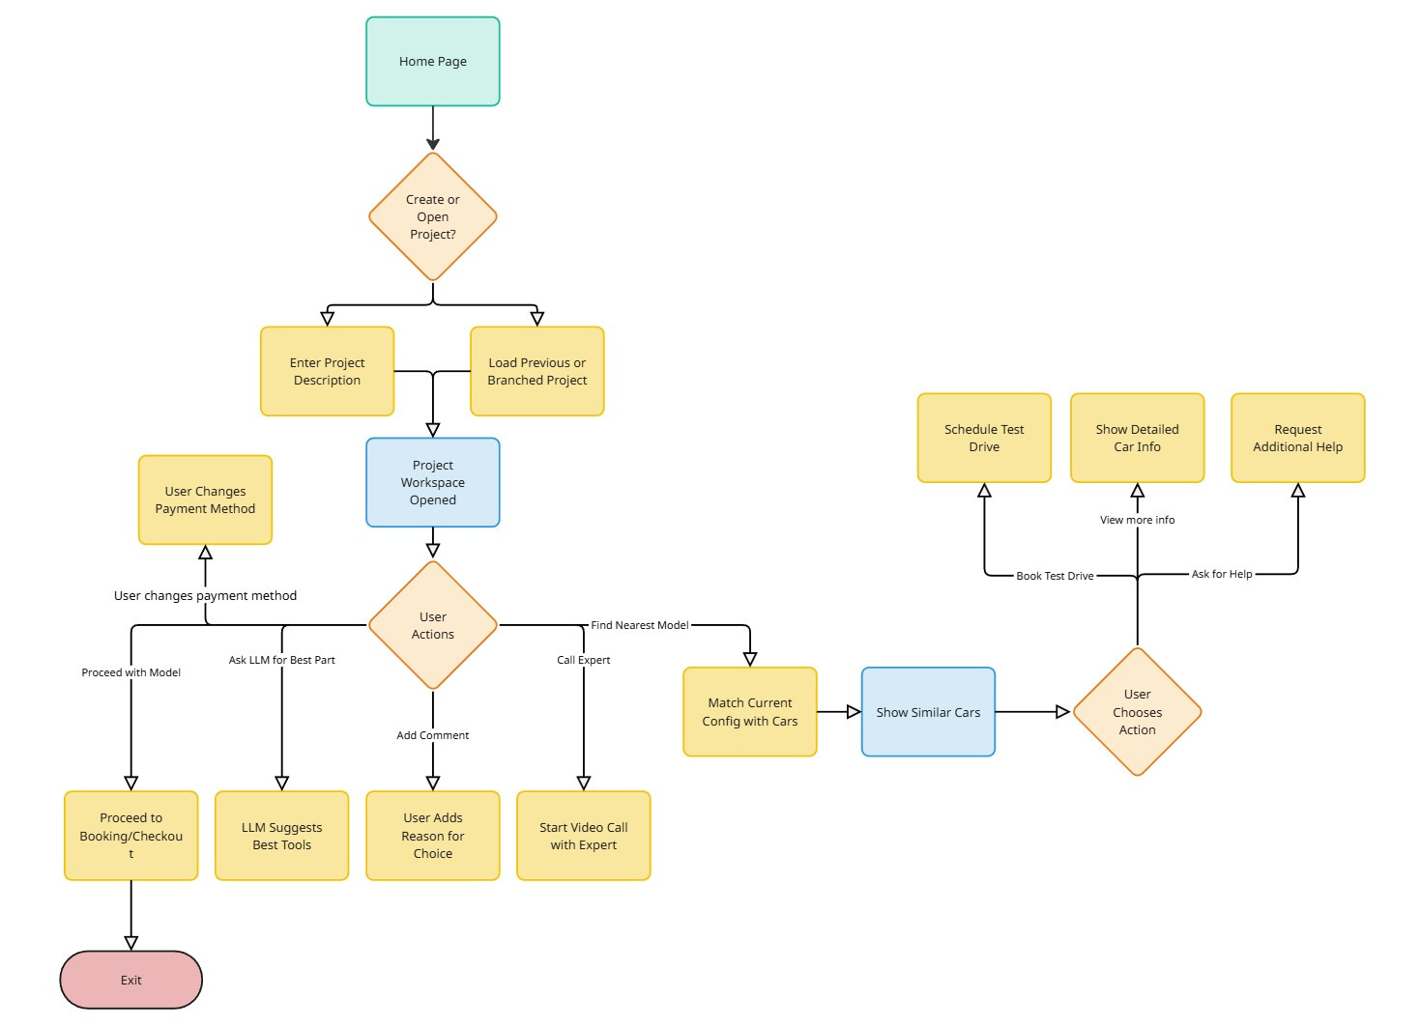
User Flow Diagram

Slide 6
System Architecture
Frontend
Next.js for dynamic UI
Socket.IO Client for real-time collaboration
Tailwind for styling
Backend
Node.js APIs
Socket.IO Server for multi-user sync & conflict resolution
Pricing Engine: feature-based pricing, EMI & lease calculations
AI Recommendation Engine
Python/Node microservices
Suggests variants, parts, and alternatives
Database Layer
MongoDB → models, trims, features, pricing
Redis → real-time collaboration state

